Slide 1
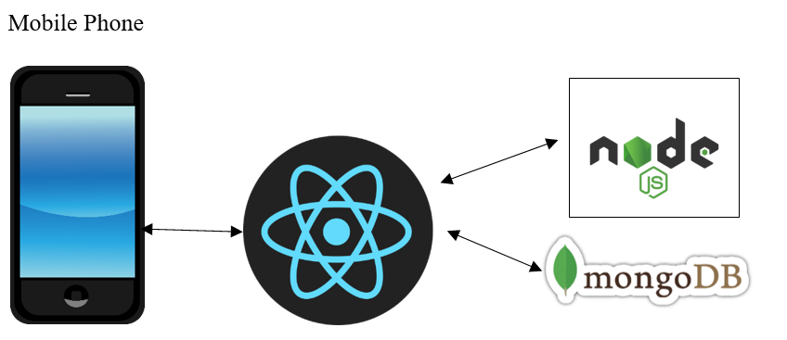
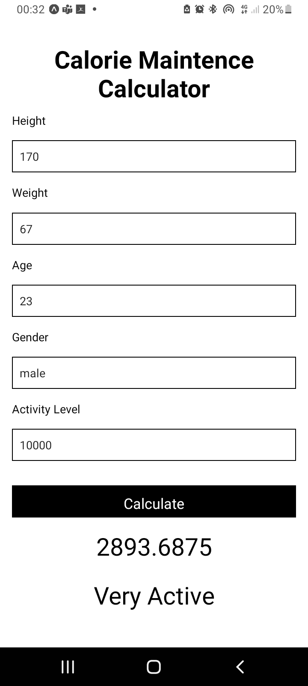
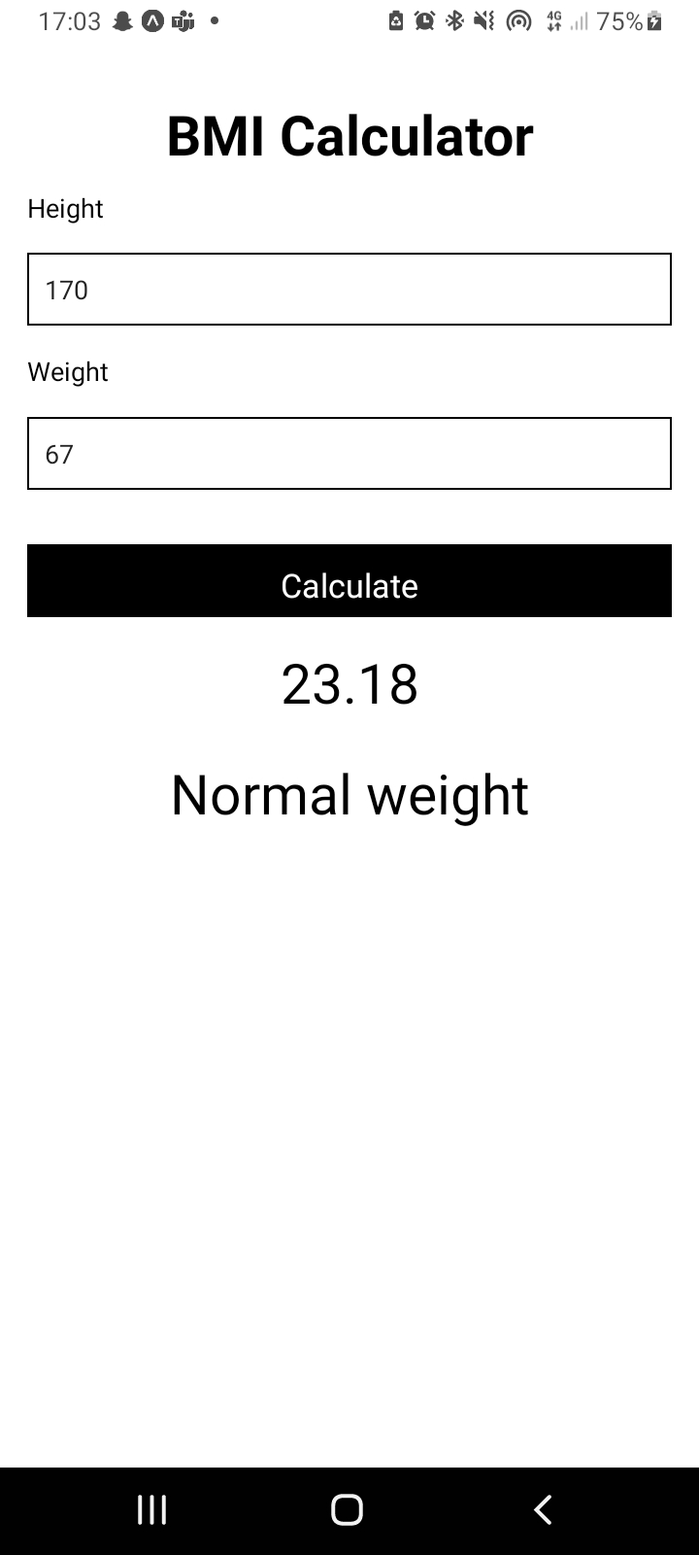
Fit-Life Application
Why did I decide to do this project?
I wanted to make a fitness app as I have a great interest in fitness and nutrition, and I wanted to make a Calorie maintenance counter and BMI calculator to help people on there fitness journey.
Activity Levels.
Sedentary = 0 – 5000 steps per day.
Lightly Active = 5000 – 7500 steps per day
Active = 7500 – 10,000 steps per day
Very Active = 10,000 steps and Higher
Shane Crotty
Atlantic Technological University
Software and electronic engineering
Calculate your Daily food intake with us.
Take your fitness goals to the next level.
Take control of your body
Make your Fitness and health a essential part of your day.
BMR = 66+(13.7 x weight(kg)) + (5 x height(cm)) – (6.8 x age)
TDEE = BMR * Activity Level
BMI | Weight Status
Below 18.5 | underweight
18.5 – 24.9 | Healthy
25.0 – 29.9 | Overweight
30.0 and above | Obese
React native / expo
Expo Go
MongoDB
Node.js
Visual Studio code.
JavaScript
Total Daily Energy Expenditure (TDEE) is the total amount of calories your body burns in 24 hours
Workout Plan Included

